Slide 1
Resolution predicate
Banciu Andrei

Slide 2
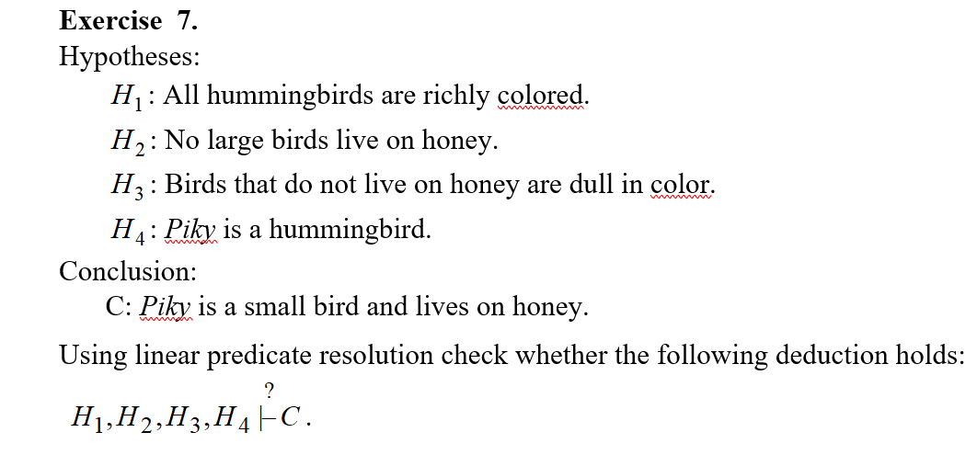
Problem statement

Slide 3
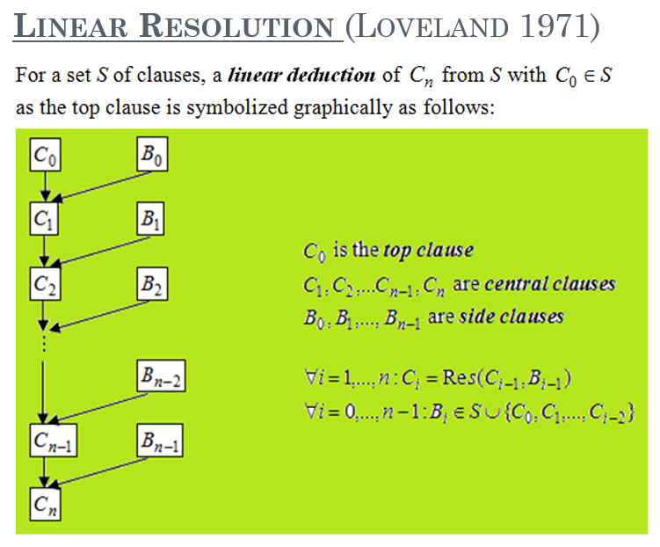
Theoretical results

Slide 4

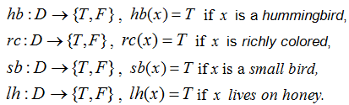




FIRST-ORDER (PREDICATE) FORMULAS

Slide 5






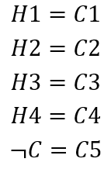
Conversion
becomes
->
becomes
->
becomes
->
becomes

Slide 6
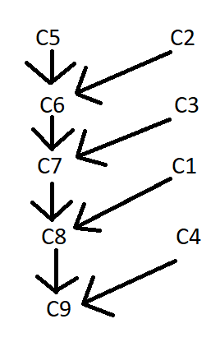
Linear predicate resolution
We choose C

Slide 7
Conclusion

